Slide 1


Australian Football League Dashboard
Project 2 – Group 1
Team member:
Samra, Nga, Serena, Ishaan

Slide 2
Agenda
Background of the project
Data Munging Process: API-CSV-PostgreSQL
Coding Approach: JavaScript, HTML, AnyChart library, D3 library, Seaborn, Pandas.
Data Visualisation:
Diverging Stacked Bar Chart: Team Performance Overview
Choropleth Map :Historical Score Points by State
Seaborn Heatmap :Win Loss Rate Between Teams
Scatter Plot: Comparison of Detailed Team Performance

Slide 3
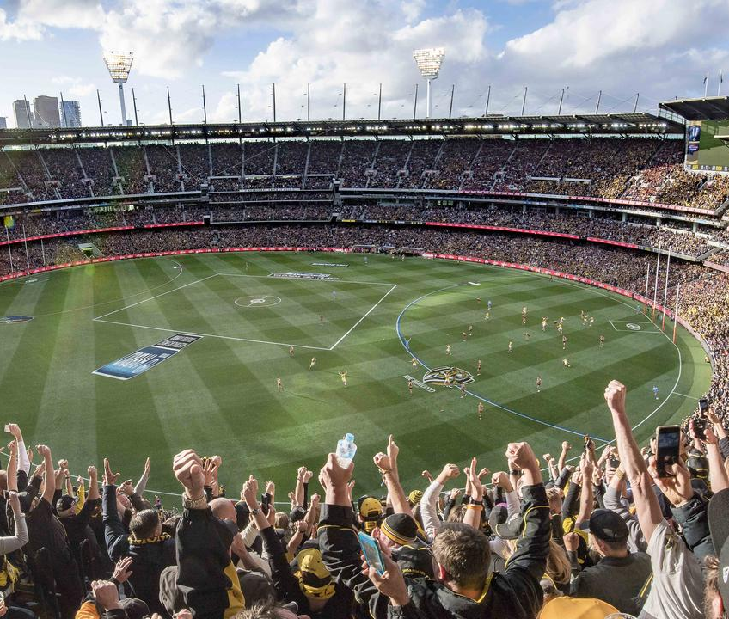

Data Munging Process
Required AFL data for this project was
extracted by requesting API calls.
We used Squiggle API to obtain the
data.
The Squiggle API offers public
access to raw data about AFL.

Slide 4
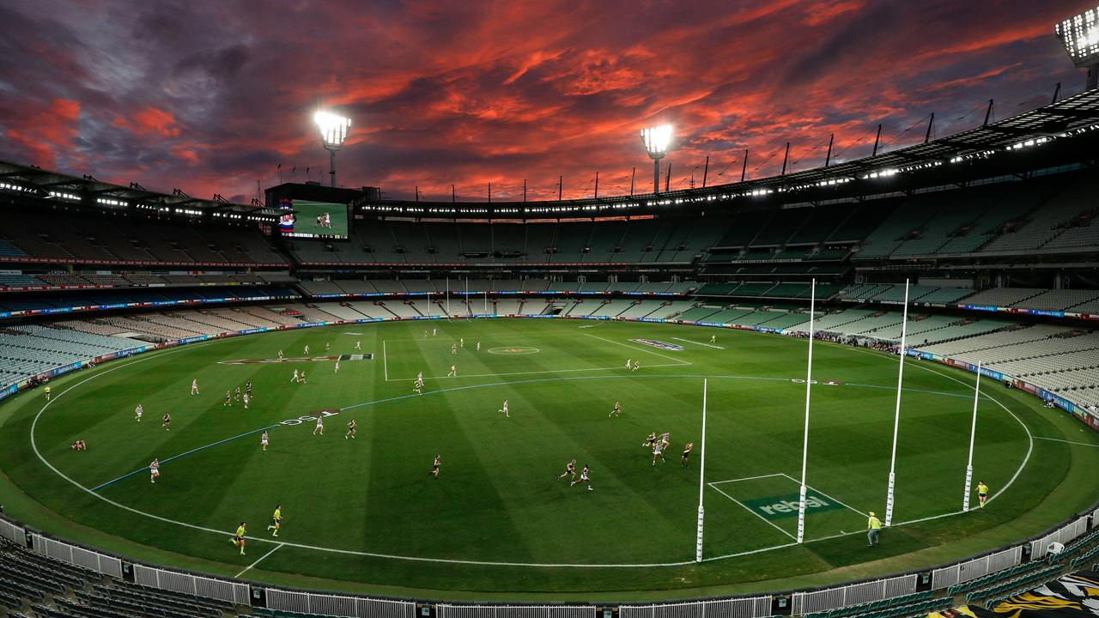

Coding Approach
Using Jupyter Notebook and pandas,
we cleaned and transformed the data according to our needs.
Based on structure of data frames,
PostgreSQL was our database of
choice.

Slide 5
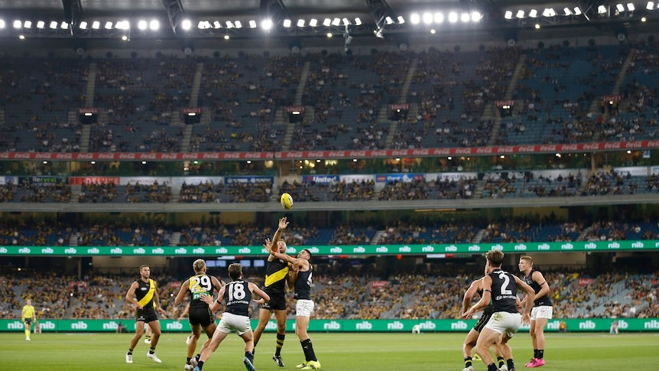

Databasing
We created out table schemas via Quick
DBD and created our PostgreSQL relational database.

Slide 6
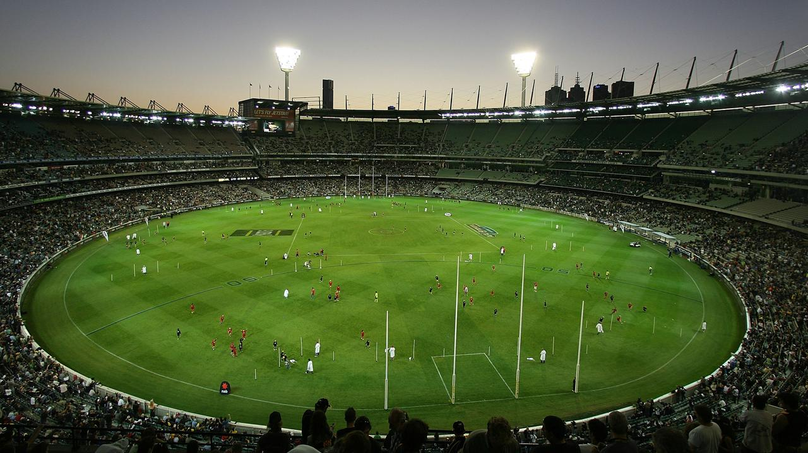

Data Visualisation
We used JavaScript libraries (D3 and AnyChart) to draw insightful AFL team performance visualisations.

Slide 7
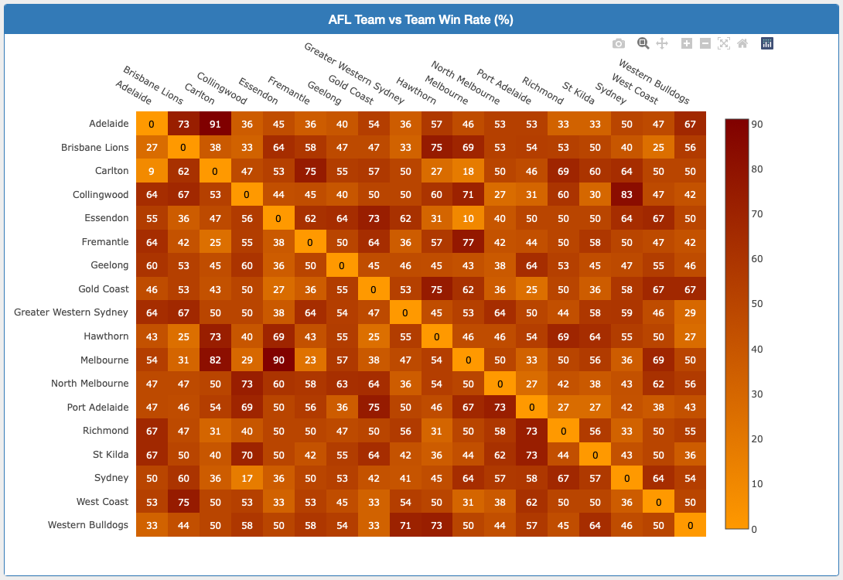
AFL Team vs Team Win Rate %

Slide 8
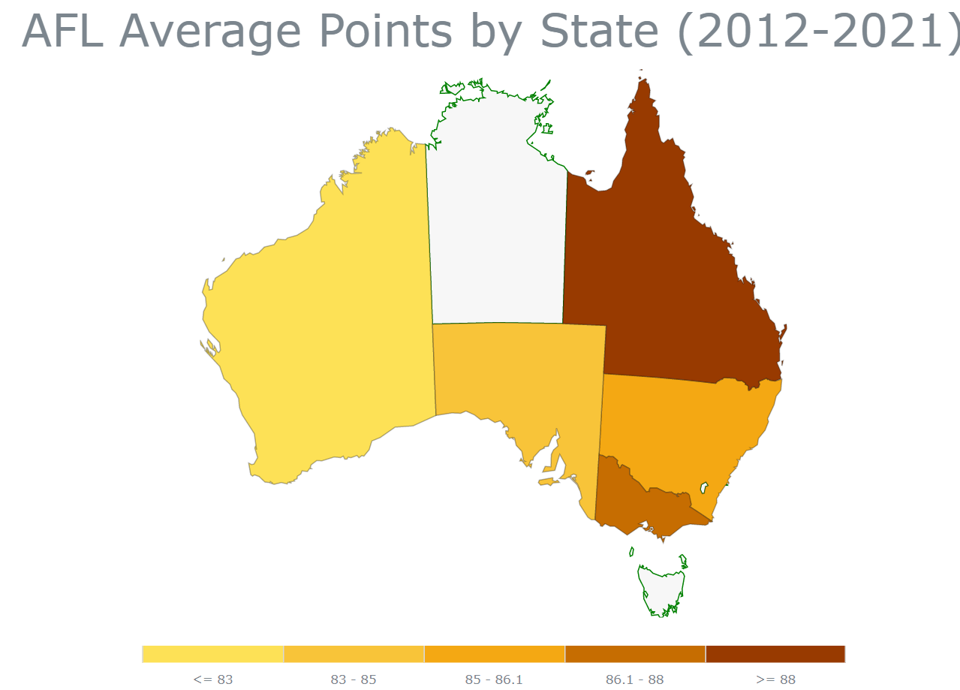
Historical Average Points Overview by State

Slide 9
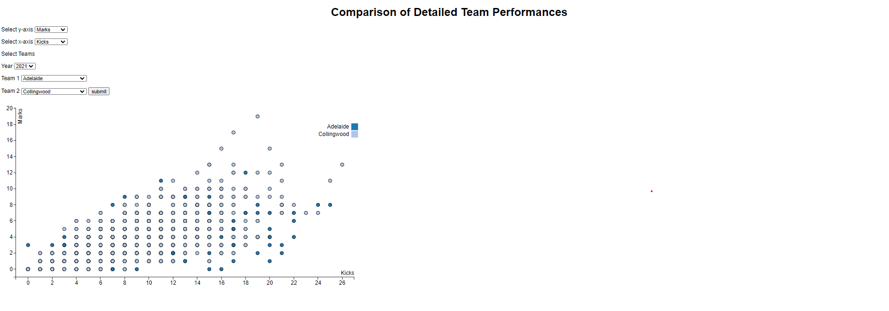
Detailed Comparison of Team Performance
Behind: A minor score, as judged by the goal umpire. Behinds are worth one point to a team’s total score.
Disposal: Legally getting rid of the ball, via a handball or kick.
Goal: A major score, as judged by the goal umpire. Worth six points to a team’s total score.
Hitout: Knocking the ball out of a ruck contest following a stoppage with clear control, regardless of which side wins the following contest at ground level.
Kick: Disposing of the ball by foot. Including kicks off the ground.
Handball: Disposing of the ball by hand.
Mark: When a player catches (is deemed to have controlled the ball for sufficient time) a kicked ball that has travelled more than 15 metres without anyone else touching it or the ball hitting the ground.
Tackle: Using physical contact to prevent an opponent in possession of the ball from getting an effective disposal.

Slide 10
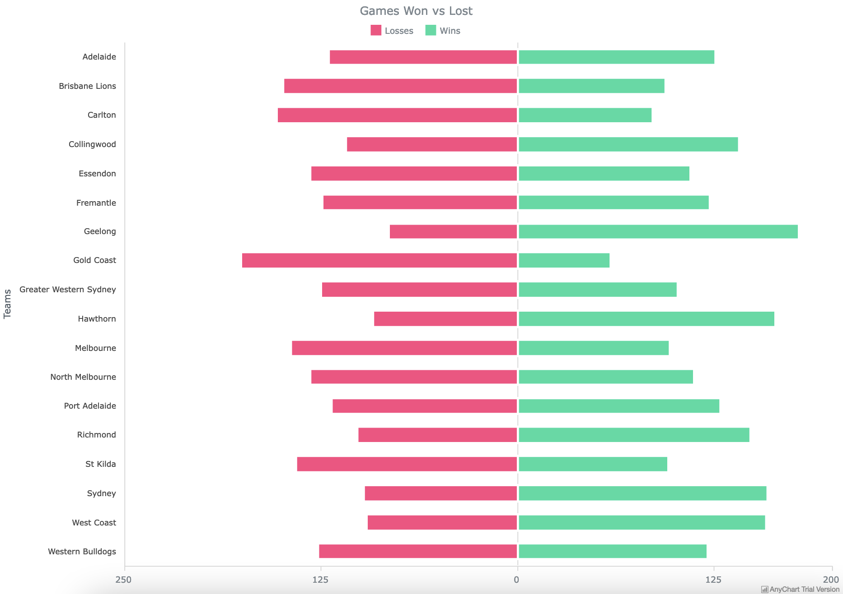
Diverged Stacked Bar Chart

Slide 11
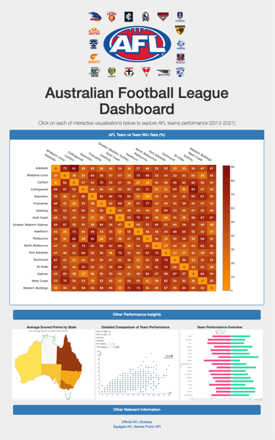

Slide 12


